Slide 1
Communication Networks-Traffic Prediction Using Machine Learning
by Aslihan Reyhanoglu
Notes:
My name is Aslihan Reyhanoglu, and welcome to my MSc Project defense. So thank you for coming here. I'm here to tell you about Communication Networks-Traffic Prediction Using Machine Learning.

Slide 2
OUTLINE
literature review
implementations of machine learning in communication area
traffic prediction using machine learning in communication netwoks
goal/objectives of the research
background
dataset
methodology
results
conclusion
Notes:
The increase in traffic on the mobile network will cause dissatisfied of costumers due to traffic overloading. It is known that something needs to be done to increase customer satisfaction by using available radio resources efficiently. The quality of service can improved by analyzing mobile networks and customers’ behaviour. In this study, practical implementations of machine learning algorithms based on a data-driven architecture to predict data traffic on the network is introduced as a solution.
My talk is divided into 7 main sections… First, literature review second, goal/objectives of the research, third background forth dataset fifth methodology next one results and conclusion

Slide 3
Literature Review
In the last years, algorithms of machine learning to apply autonomous operations in networks have been investigated(Polese, 2019). Optimization of video flows (Zorzi,2017), energy efficient networks(Li, 2015) and resource allocation (Chinchali, 2018) can be given as examples for the studies made. The study (Jiang cited in Polese et al) surveyed the importance of machine learning for next-generation 5G networks. It gives information about the appropriate methods of machine learning.

Slide 4
Chen et al(2018) pointed out that it is not easy to predict and characterize the patterns of traffic because the traffic pattern of each base station is active at different positions and time. Moreover, they suggested a structure of C-RAN optimization using deep learning to solve the difficulties. By utilizing the multivariate Long Short Term Memory (MuLSTM) model they aimed to understand the spatial correlation and the temporal dependence between traffic models of base stations and to forecast traffic more accurately for the future. In addition, Telecom Italia Dataset which is data of a real-world network was used in this study.

Slide 5
Chuai et al(2019) studied on a model which integrates analysis of real-world telecommunication data and multivariate forecast system, fitting for communication networks in urban areas. Furthermore, they claim that causality analysis operated in practice first time while analysing telecommunication data which was taken by utilizing from the spatial-temporal model. Using the multivariate LSTM algorithm, future traffic data were also predicted with the obtained data from the analysis. Based on the outcomes of the experiment, they emphasize that causality analysis can increase the forecasting performance of multivariate time series.

Slide 6
Jiang et al. (2017) studied machine learning paradigms for next-generation wireless networks. They addressed that the next- generation wireless networks are assumed to be supported higher data rates and all recent implementations working in the paradigm of wireless radio technology. Moreover, it was forecasted that the future smart terminals of 5G are predicted to autonomously reach high spectral bandwidths with the help of the sophisticated spectral efficiency inference and learning.Jiang et. al(2017) claimed that machine learning is one of the most promising artificial intelligence tools, conceived to support smart radio terminals.

Slide 7
Goal/Objectives of The Research
The aim of this project was to examine the structure of communication networks and to introduce a data-driven architecture for the practical applications of machine learning techniques to predict data traffic on a network.
Objectives:
To examine the existing machine learning implementations in communication networks
Processing of the dataset to make it easy to use;
Implementation of machine learning algorithms;
Evaluation of accuracy;

Slide 8
Why have big data analysis and machine learning began to be used in communication networks?
The development of smartphones with the acceleration of technological changes in recent decades has led to an increase in the production of big data and even a burst. Mobile traffic which is one of the data sources is said to be able to reach 20 percent of internet traffic by 2021 (Chuai et al,2019).
The big data in communication networks includes information related to customers' patterns of activity towards time, space and frequency. The quality of service and spectral efficiency can improve by using spectral patterns in the big data.(Liu, 2019).

Slide 9
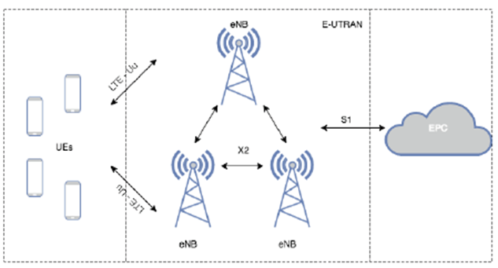
Radio Access Network(RAN)
The radio access network (RAN) has been used in all generations of cellular technology from 1G to 5G.
RAN occurs from a base station and antennas which cover a dedicated area based on their capacity.
Radio sites in a RAN ensure radio access and arrange the resource management among the radio sites.
When a device is connected to the core network wirelessly, the RAN sends its signal to different endpoints of wireless, and the signal travels with other networks’ traffic.
Notes:
Raw data used comes from Radio Access Network (RAN) .Machine Learning methods have been applied to unstructured big data in RAN to provide patterns and to obtain information about the situation of network and make better resource allocation.

Slide 10
Machine Learning in RAN
The prediction is so important for many scientific areas, and to make predictions from data is a key point of machine learning. Machine learning algorithms are able to learn from unstructured big data in the Radio Access Network(RAN) to assure patterns which are efficient for base stations to learn about network condition and to improve the method of resource allocation. Today, data traffic on a mobile network is to enhance while Internet-enabled smartphones and tablets are increasingly popular (Zheng et al., 2016).

Slide 11
The regression algorithms were selected by taking consideration of literature review. The algorithms used are below;
Linear Regression
Support Vector Machine
Decision Tree
Feedforward Neural Network
Notes:
Linear Regression:
Linear regression(LR) is a classical method which is widely used for time series forecasting. In previous research, It has seemed that LR was extensively used for traffic prediction
Support Vector Machine:
SVM Regression which is a nonlinear model can deal with nonlinearities of cellular network. When SVM was created, it was utilized input arguments which are kernel function, gaussian and standardize true, in addition to predictor values and test values.
Decision Tree
Decision tree is easy to use, flexible and versatile. The obtained tree is a binary tree where every branching node is divided depends on the values of predictor data column.
Feedforward Neural Network:
Feedfoward neural network is able to handle comlex networks:
As the model of network was generated, input arguments used are 50 neurons,1 hiddenlayer, trainscg( scaled conjugate gradient ) as a train function.
Trainscg's purpose is to update values of bias and weight according to the scaled conjugate gradient method(MATLAB).

Slide 12
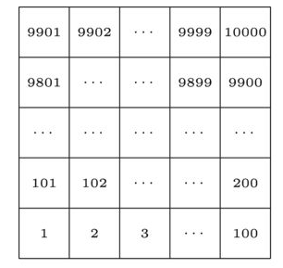
Dataset: Telecom Italia(Milan)
Although there are so many different kinds of CDRs, It has considered that telecom
Italia used the activities below when creating this dataset:
Received SMS: a CDR created each time when a customer received an SMS
Sent SMS: a CDR created each time when a customer sends out an SMS
Incoming Calls: a CDR created every time when a customer receives a phone call
Outgoing Calls: a CDR created every time when a customer issues a call
Internet: a CDR created each time
* when a customer starts a connection
*when a customer ends a connection
*when one of the upper limits below is attained during the same connection:
o 15 minutes from the latest created CDR
o 5 MB from the latest created CDR
Milan Grid
Milan city is divided into 10000 cell ids
Notes:
The data used is the publicly avalable Call Detail Record provided by Telecom Italia. The record of data was held for 8 weeks in Milan city of Italy, contains temporal and spatial data. Traffic in each area changes in real-time and the trend of change is different. Therefore, the system can be considered as dynamic.
Call Detail Records (CDRs) indicate activities of customers and they are used to bill customers, and handle the network issues.

Slide 13
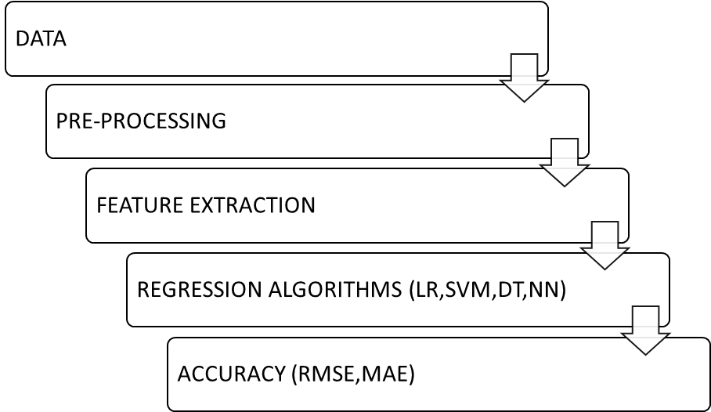
Methodology
Notes:
This is the method followed when applying the project. Data->Data Pre-processing->Feature Extraction->Algorithms->Accuracy

Slide 14
Data Pre-processing
In this Project , internet traffic activity was analysed.
Internet traffic activity data of 100 areas from different parts of Milan were extracted according to spatial information(according to their Square ID).
After the internet traffic activity data was extracted, the data in the first seven weeks was used to generate the training dataset, and the data in the last week was utilised to create the test dataset to test the accuracy of the different forecasting algorithms.

Slide 15
The missing values in the data of each area were completed using the linear interpolation method.
The previous values of internet traffic activity are used to estimate future values in each area. In other words, N-previous value was used as a feature vector.
The dataset was adapted to supervised learning by using v_enframe, one of the voice box algorithms developed for Matlab. V_enframe frames the vector pretending to be (overlapping) the signal. Thus, predictor values and target values to be used to feed algorithm models were obtained.
After these processes, prediction was made. MAE and RMSE accuracy values were measured.

Slide 16
Results
Notes:
MAE and RMSE values of 100 square ids were calculated separately for each algorithm.
After that step, the mean values of the MAE and RMSE values of each algorithm were calculated. The comparisons of traffic prediction performances of algorithms are like on the graph. While The worst one is linear regression, the best one is SVM in this project

Slide 17
Results
Algorithms/Accuracy | RMSE | MAE
Linear Regression | 160.78 | 55.18
Support Vector Machine | 105.65 | 47.16
Desion Tree | 158.39 | 61.87
Neural Network(Feedforward) | 108.67 | 53.61
Notes:
You can see the exact MAE and RMSE values of four algorithms.

Slide 18
Conclusion
While Linear Regression shows the worst performance, Support Vector Machine has the best one. There is a big difference between the values of Linear Regression and Support Vector Machine. The reason to get a better result for Support Vector Machine regression is that it can handle the nonlinearity of mobile traffic. Linear Regression has not enough parameter space to deal with the complicated dynamics of mobile traffic.
Notes:
Overall
Network optimization is a significant solution to allocate resources fairly due to complication of a communication network.
Machine learning suggests a more intelligent and higher-level control and management of networks to meet different requirements of users
Future Work
The mobile traffic is affected by external factors. Therefore, this would be extended by using external factors such as the number of base stations and social activity. When examining the previous research made related to this topic, it was mentioned the power of RNN algorithm. It has thought that RNN can be suitable for this Project to obtain better performance.

